Slide 1
CROP RECOMMENDATION SYSTEM USING MACHINE LEARING
MANO S (312418205046)
KARTHIKEYAN S (312418205037)
Guided By:
Dr.M.K.KIRUBAKARAN M.E., Ph.D

Slide 2
OBJECTIVE
Focuses to recommend most suitable crop for cultivation of farmers
Failure of farmers to decide on the most-suited crop for the land using traditional and non-scientific methods is a serious issue for a country where approximately 58 percent of the population is involved in farming.
To recommend the crop. Which has high yield over the environmental factors.
This system recommends the most suitable crop using the ML model

Slide 3
ABSTRACT
Agriculture is being implemented with a modern agricultural technology. The data has collected and analyzed.
Machine learning model has been created for a recommendation system which recommends the best suitable crop.
Accuracy of algorithm has measured using different machine learning techniques and analyzed.
Model has been packed as a pickle file which has used in API to connect the web application and model for recommendation.

Slide 4
LITERATURE SURVEY
S.NO | Title, Author, Year | Technique used | Description | Remarks
1 | Crop Prediction Based on Characteristics of the Agricultural Environment(S.P. Raja; Barbara Sawicka;Zoran Stankovic; and G.Mariammal,IEEE Access, volume:10,2022) | Machine Learning Algorithms, Data Analysis. | The proposed model predicts the crop based on the characteristics of environment.. | Certain characteristics of the model makes the decision to be biased.
2 | Agricultural Crop Recommendation based on productivity and Season. (Vaishnavi.S, Shobana.M, Sabitha.R, Karthik.S, 2021) | Neural Networks, Analysis Techniques. | Clustering approaches such as k-means algorithm predicts the amount of harvest of crops and also water requirements for crops. | Model uses production and season as major parameters for recommendation, this leads to a biased results.

Slide 5
LITERATURE SURVEY
S.NO | Title, Author, Year | Technique used | Description | Remarks
3 | Cascading Feature Filtering and Boosting Algorithms for Plant Type Classification Based on Image(Adel Bakshipour: IEEE Access, Volume:9,2021) | Machine Learning algorithms, Neural Networks. | Boosting algorithms are used in enhancing performance of classification of plant based on the image | Different approaches used for crop yield prediction. It makes the model more complex.
4 | Soil Sensors-Based Prediction System for Plant Diseases Using Exploratory Data Analysis and Machine Learning(Manish Kumar: Ahlad Kumar; Vin S.Palaparthy, IEEE Sensors Journal, volume 21,Issue:16, 2021). | Neural Networks, Analysis Techniques. | Soil Sensors are used to collect data, data has been used in EDA and machine learning to find plant diseases. | Sensors provides some defective result on environmental situations. This may leads to false prediction

Slide 6
LITERATURE SURVEY
S.NO | Title, Year, Author | Technique used | Description | Remarks
5 | Weather Based Crop Prediction in India using Big Data Analytics(Rishi Gupta, Akhilesh Kumar Sharma, Krishna mode, Shahreen Kasim, Zirawani Baharum, IEEE Access, Volume 9, 2021) | Machine Learning Algorithms. | Crop has been predicted based on the weather condition analytics. | Weather conditions changes every year tremendously sometimes this may lead to wrong prediction

Slide 7
EXISTING SYSTEM
While making a crop recommendation every characteristics of environment must be considered.
This only use certain parameters to make a recommendation. In their system they only use parameters to get recommendation.
In this system different algorithms are used for different characteristics, which gives most result for particular environment.
productivity-based recommendation they are using ensemble technique, they use k-means algorithm and clustering analysis in productivity and season-based recommendation.

Slide 8
LIMITATIONS
System provides a biased result over certain characteristics.
Failure of system to recommend a most suitable crop.

Slide 9
PROPOSED SYSTEM
In the proposed system the environmental parameters such as, temperature, and potassium, nitrogen, pH value, and rainfall all the factors are being considered to recommend a suitable crop to the user.
In this system all the agricultural factors are cumulative considered for recommendation, in this system use random forest algorithms which is collection of decision tree algorithms.
In this system all the agricultural factors are cumulative considered for recommendation, in this system use support vector classifier algorithm.

Slide 10
ADVANTAGES
Support Vector Machine is effective in cases where there are more dimensions.
The support vector machine has high computational efficiency.
Highly suitable for small amount of data.
The accuracy of an model is improved.

Slide 11
SYSTEM ARCHITECTURE
Data Pre-process
Kaggle Dataset
Model Selection
Testing
Model
Model
Feature Selection
Training Data
Confusion Matrix
Handling Missing Values
User
Hyperparameter Tuning
Accuracy
Crop Recommendation
Balancing Data
Support Vector Classifier
Application Web framework
Crop Recommendation System
Test and Training Data Split 80:20 ratio
Pickle File
Web application

Slide 12
SYSTEM REQUIREMENTS
SOFTWARE REQUIREMENTS
Operating system : Above Windows 7 Professional.
Coding Language : Python.
Tool : Jupyter, Anaconda, Spyder
API : Steamlit
HARDWARE REQUIREMENTS
Processor : Intel i3
Hard Disk : 1TB
RAM : 4GB

Slide 13
MODULES
Data Collection
Exploratory Data Analysis
Data Visualization
Data Modelling
Deployment

Slide 14
MODULES DESCRIPTION
DATA COLLECTION
Data is important part of this project, all the recommendations are made by the model that uses dataset for the training. Dataset must be more accurate to make a good recommendation, as data base part of recommendation dataset most not biased.
Dataset must not be an old because every decade the climate conditions has been changing and agriculture cycle also change, data must be in a current to get best result for user.
Dataset from Agriculture research websites and Kaggle are used in the system Agri_crop dataset.

Slide 15
MODULES DESCRIPTION
EXPLORATORY DATA ANALYSIS
In this process we are handling all the data manipulation, which contains treatment of missing values, handling imbalanced dataset by drop the rows, if dataset contains huge number of rows or adding extra row for low amount of data.
Visualizations like heat maps, bar charts, scatter plots, heat maps are used to find the significance between the fields, and bar charts are used to find distribution of data
Data that has been split into training and testing data after performing exploratory data analysis. Data has been split into a particular ratio as testing and training data as 75:25 respectively.

Slide 16
MODULES DESCRIPTION
DATA VISUALIZATION
Data visualization is the process of creating interactive visuals to understand trends, variations, and derive meaningful insights from the data.
Data visualization can be used to understand the distribution of the data, look for central tendencies (mean, median, and mode), understand the presence of outliers using a boxplot, check for skewness, and ever understand the impact of data distribution.

Slide 17
MODULES DESCRIPTION
DATA MODELING
A model takes the organized data as input and gives the preferred output. This step consists of selecting the suitable kind of model whether the problem is a classification problem or a regression problem or a clustering problem
There must be right stability between overall performance and generalizability.
There has no longer desire the model to study the data and operate poorly on new data.
Confusion matrix has been used to find the accuracy of model, if the accuracy of the model is low hyper parameter tuning has been done to get maximum result, if the accuracy remains low the machine learning algorithm changed based on the exploratory data analysis.

Slide 18
MODULES DESCRIPTION
DEPLOYMENT
Crop Recommendation System has been deployed using streamlit and github.
Webpage for crop recommendation has fields for providing inputs to system to recommend the crop, webpage has fields nitrogen, phosphorus, potassium, temperature, humidity, ph, rainfall factors for prediction.
The inputs given by the user has been sent to model through the web API. Web API contains the file that has pickle file contain model for recommendation.

Slide 19
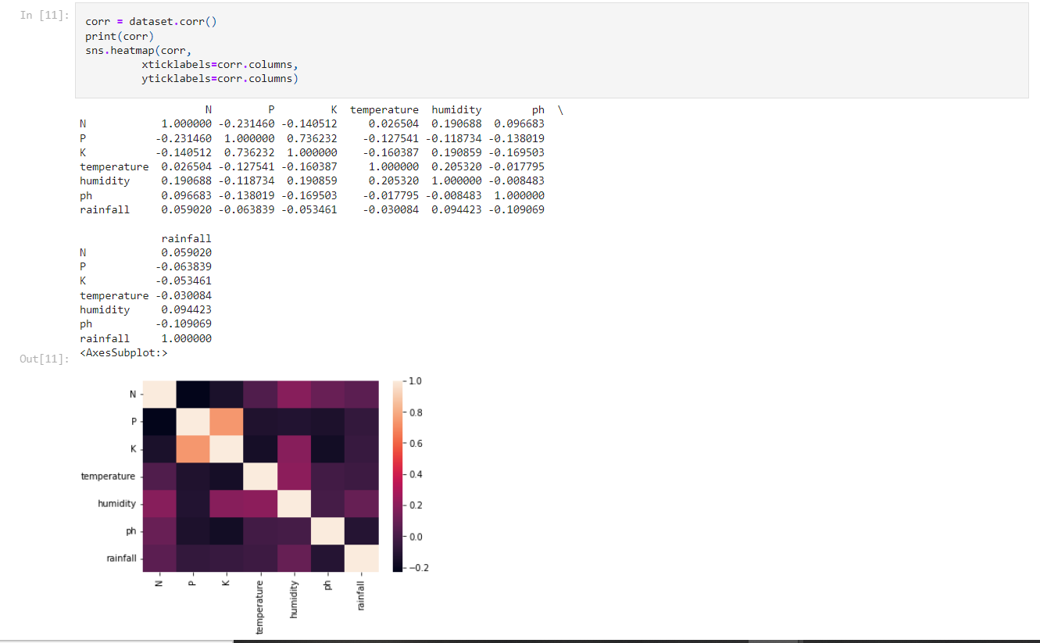
SCREENSHOTS

Slide 20
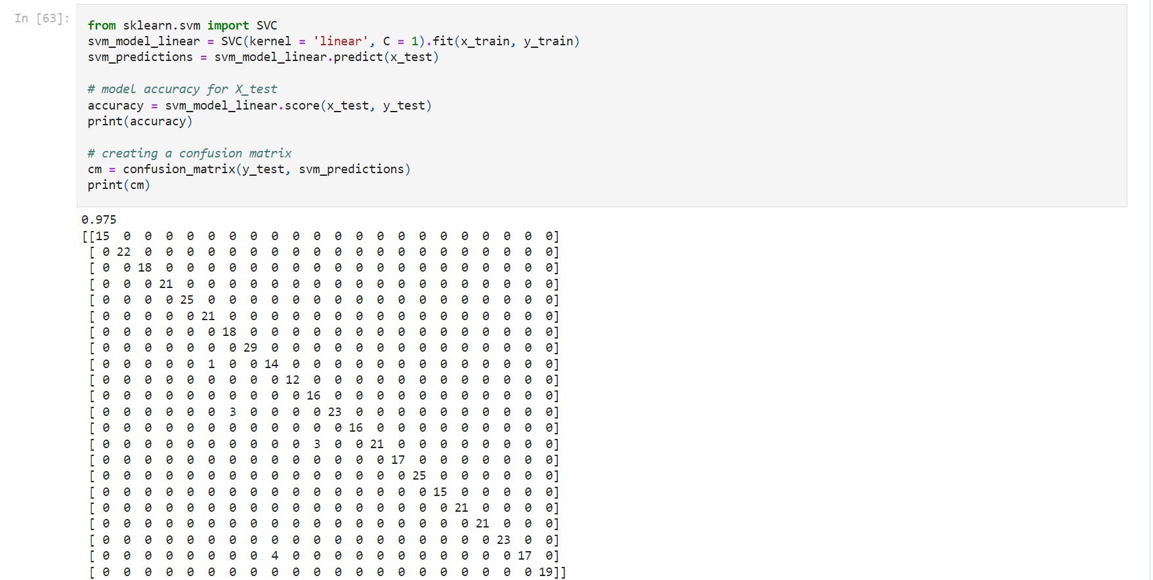
SCREENSHOTS

Slide 21
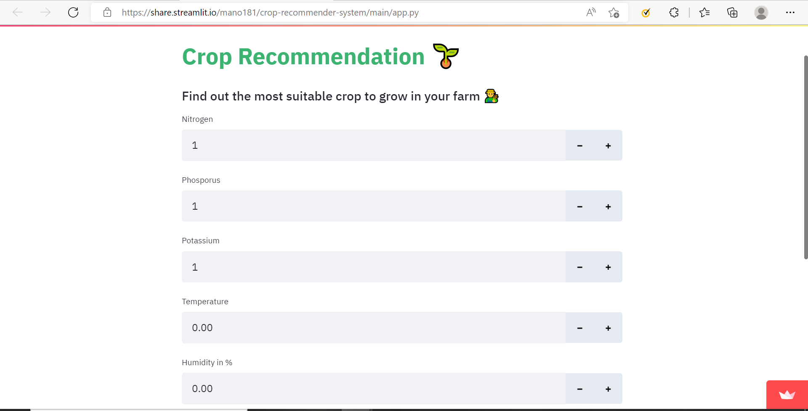
SCREENSHOTS

Slide 22
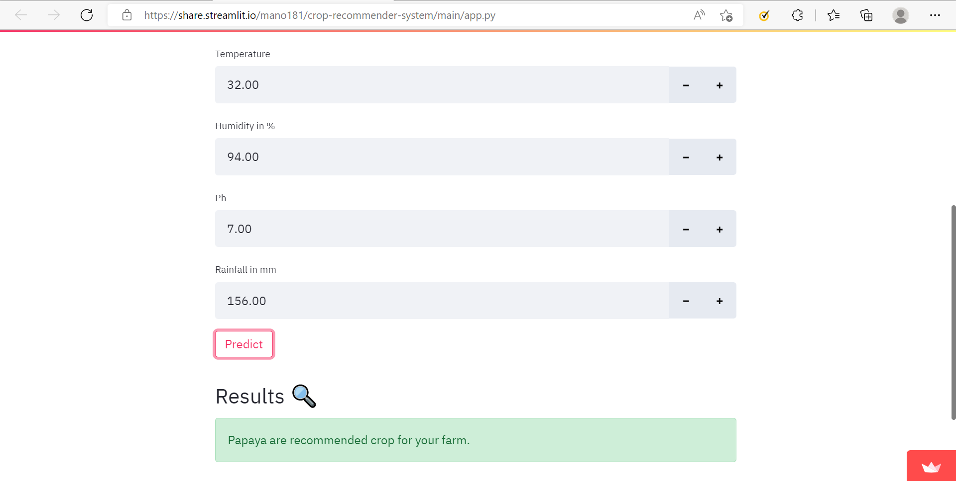
SCREENSHOTS

Slide 23
CONCLUSION
A crop recommendation system has been designed that takes into consideration the crop dataset with respect to the crops. The crop dataset is pre-processed and then the machine learning performs a critical function in the classification of the crops.
The proposed work provides a helping hand to the farmer in the accurate selection of the crop for cultivation. This creates an exponential gain in the crop productivity which in turn boosts the economy of the country.

Slide 24
FUTURE ENHANCEMENTS
More environmental factors has been included to the model for recommendation.
Procedure for cultivating a recommended crop will be included.
More varieties of crop has been included for recommendation.

Slide 25
REFERENCES
[1] S.P. Raja, Barbara Sawicka, Zoran Stankovic, and G.Mariammal “Crop Prediction Based on Characteristics of the Agricultural Environment Using Various Feature Selection Techniques and Classifiers”, IEEE Access Journal, Volume:10, 2022.
[2] Abhinav Sharma, Arpit Jain, Prateek Gupta, Vinay Chowdary “Machine Learning Application for Precision Agriculture”, IEEE Access Journal, Volume:9, 2021.
[3] Adel Bakshipour “Cascading Feature Filtering and Boosting Algorithm for Plant Type Classification”, IEEE Access Journal, Volume:9, 2021.
[4] Manish Kumar, Ahlad kumar, Vinay S.Palaparthy “Soil Sensors-Based Prediction System for Plant Diseases Using Exploratory Data Analysis and Machine Learning”, 2021, IEEE Sensors Journal, Volume:21,Issue:16, 2021.
[5] Gayathri Nagasubramanian, Rakesh Kumar Sakthivel, Rizwan Patan, Muthuramalingam Sankayya, Mahnoud Daneshmand, Amir H.Gandomi “ Ensemble Classification and IoT-Based Pattern Recognition for Crop Disease Monitoring System”, IEEE Internet of Things Journal, Volume:8, Issue:16, 2021.

Slide 26
REFERENCES
[6] Rishi Gupta, Akhilesh Kumar Sharma, Krishna mode, Shahreen Kasim, Zirawani Baharum “Weather Based Crop Prediction in India using Big Data”,IEEE Access Journal, Volume:9, 2021.
[7] Andrii Shelestov, Mykola Lavreniuk, Vladimir Vasiliev, Leonid Shumilo, Andrii kolotii “Cloud Approach to Automated Crop Classification Using Sentinel-1 Imagery”, IEEE Transactions on Big Data, Volume:6, Issue:3, 2020.
[8] Muhammad Tufail, Javaid Iqbal, Mohsin Islam Tiwana, Muhammad Shahab Alam “Identification of Tobacco Crop Based on Machine Learning for a Precision Agricultural Sprayer”, IEEE Access Journal, Volume:9, 2021.
[9] Waleej Haider, Aqeel-Ur Rehman, Nouman M. Durrani, Sadiq Ur Rehman “A Generic Approach for Wheat Disease classification and Verification Using Expert Opinion for Knowledge-Based Decisions”, IEEE Access Journal, Volume:9, 2021.
[10] Bo cheng, Wanyin Wu, Dapeng Tao, Shibo Mei, Ting Mao, Jun Cheng “ Random Cropping Ensemble Neural Network for Image Classification in a Robotic Arm Grasping System”, IEEE Transactions on Instrumentation and Measurement, Volume:69, Issue:9, 2020.

Slide 27
REFERENCES
[11] Rayner Alfred, Joe Henry Obit, Christie Pei- Yee Chin, Haviluddin Haviluddin, Yuto Lim “Towards Paddy Rice Smart Farming: A Review on Big Data, Machine Learning, and Rice Production Tasks”, IEEE Access, Volume:9, 2021.
[12] Alsulaiman, Mohammed Arafah, Mohamed Amine Mekhitiche “Intelligent Harvesting Decision System for Date Fruit Based on Maturity Stage Using Deep Learning and Computer Vision”, IEEE Access Journal, Volume:8, 2020.
[13] Zengwei Tang, Hong Wang, Xiaobing Li, Xiaohui Li “An Object-Based Approach for Mapping Crop Coverage Using Multiscale Weighted and Machine Learning Methods”, IEEE Access Journal, Volume;13, 2020.
[14] Waleej Haider, Aqeel-Ur Rehman, Nouman M. Durrani, Sadiq Ur Rehman “A Generic Approach for Wheat Disease Classification and Verification Using Expert Opinion for Knowledge-Based Decisions”, IEEE Access Journal, Volume:9, 2021.
[15] Shantam Shorewala, Armaan Ashfaque, R.Sidharth, Ujjwal Verma “Weed Density and Distribution Estimation for Precision Agriculture Using Semi-Supervised Learning”, IEEE Access, volume:9, 2021.

Slide 28
THANK YOU

